Slide 1
E-retail factors for customer activation and retention (A case study from Indian e-commerce customers)
Prepared by:
Akata Yadav

Slide 2
Contents
Problem statement and understanding
EDA Steps, visualizations and assumptions used to complete the project
Analysis, Observation & Conclusion.

Slide 3
Problem statement : Factors for growth of Online Store
Nowadays, e-Commerce or Online store is one of the growing business.
Many businessmen and entrepreneurs : focused on rapid expansion of Online store.
From customer point of view, Online store will not only reduce people’s time but also give a large option at one place to chose the correct product.
However, success of Online store or e-Store is most importantly dependent on Customer satisfaction. It is one of the most important factors that guarantees its success.
Customer satisfaction is a key stimulant of :
purchase,
repurchase intentions, and
customer loyalty.

Slide 4



Problem statement : Factors for growth of Online Store
Five major factors that contributed to the success of an e-commerce store have been identified as:
service quality,
system quality,
information quality,
Trust, and
net benefit.

Slide 5
Need to identify Factors for Online Store
The research investigated the factors that influence the online customers repeat purchase intention.
The combination of both utilitarian value and hedonistic values : needed to affect the repeat purchase intention (loyalty) positively.

Slide 6
Method for study of Factors for Online Store growth
A comprehensive review of the literature, theories and models have been carried out to propose the models for customer activation and customer retention.
The data is collected from the Indian online shoppers.
Results will indicate the e-retail success factors, which : very much critical for customer satisfaction.

Slide 7
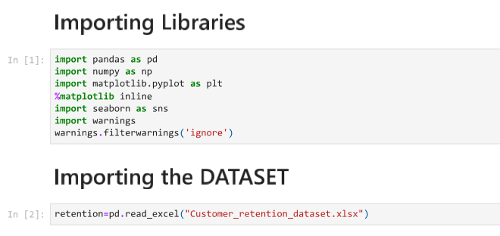
Steps and assumptions for data study

Slide 8
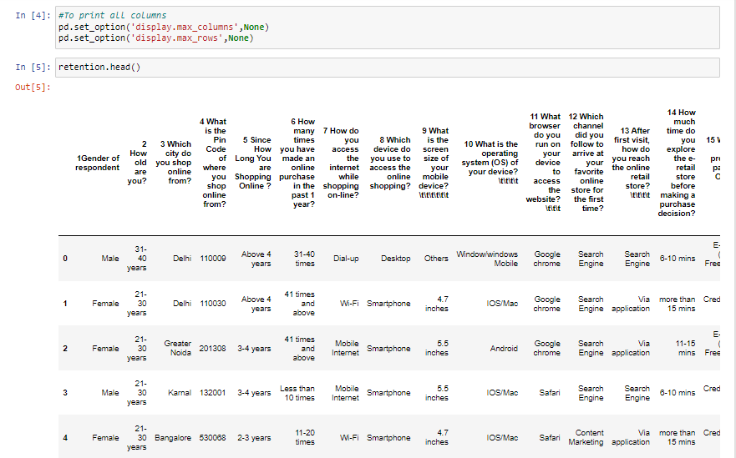
Retrieving Datasheet

Slide 9
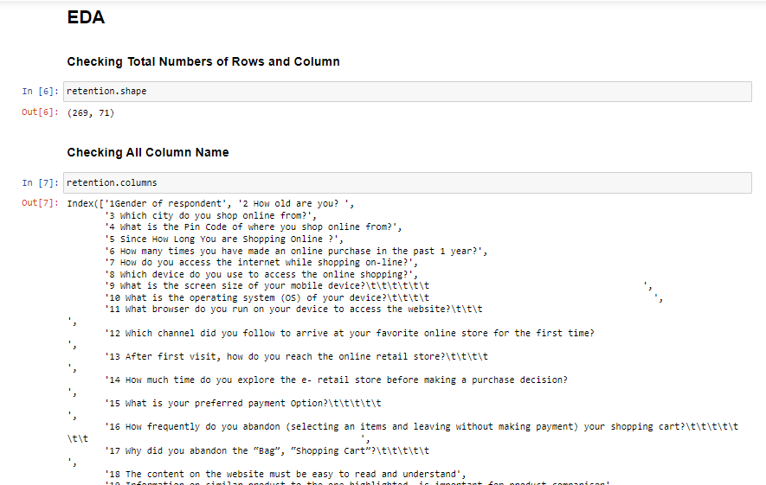
EDA Steps and assumptions for data study

Slide 10
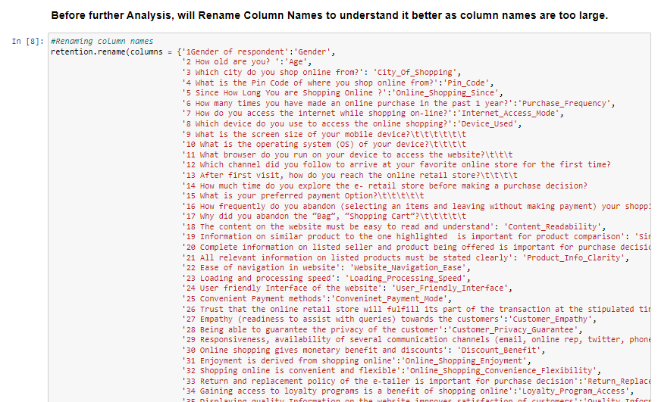
EDA Steps and assumptions for data study

Slide 11
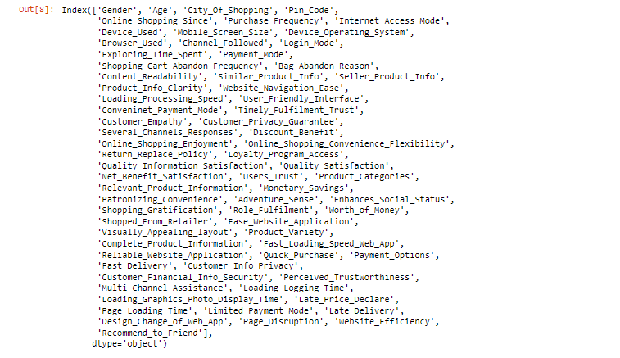
EDA Steps and assumptions for data study

Slide 12
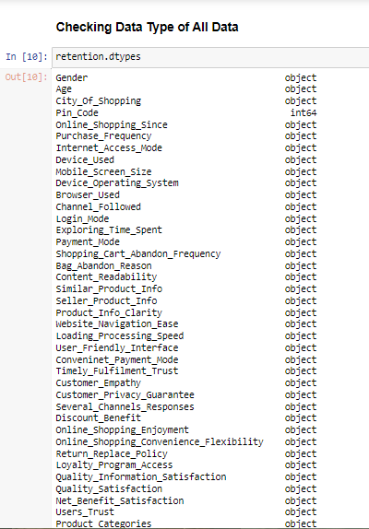
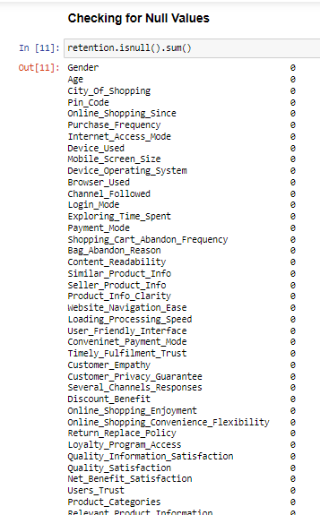
EDA Steps and assumptions for data study

Slide 13
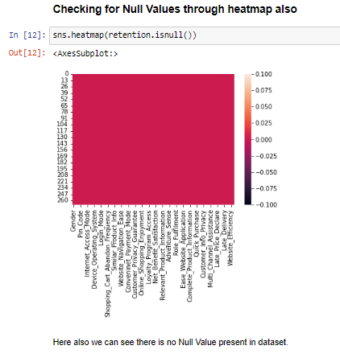
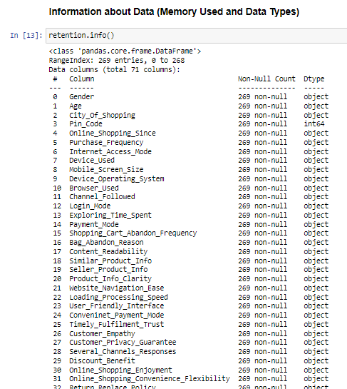
EDA Steps and assumptions for data study

Slide 14
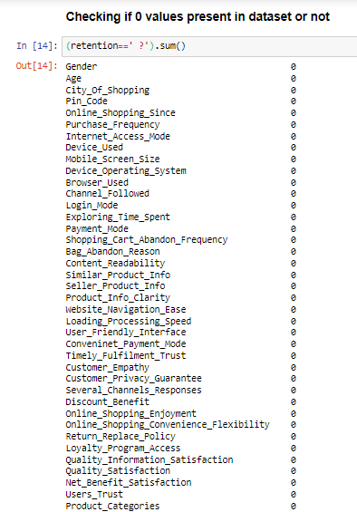
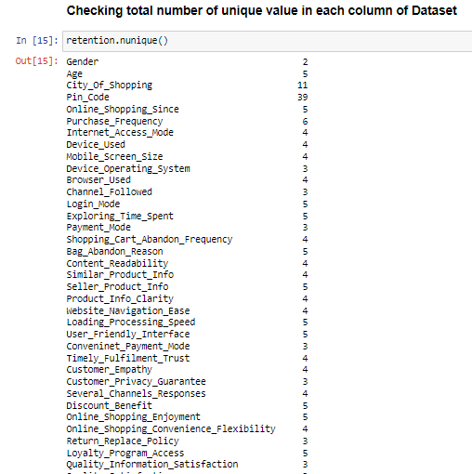
EDA Steps and assumptions for data study

Slide 15
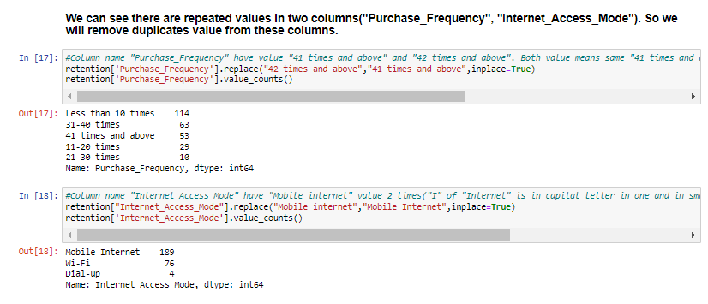
EDA Steps and assumptions for data study

Slide 16
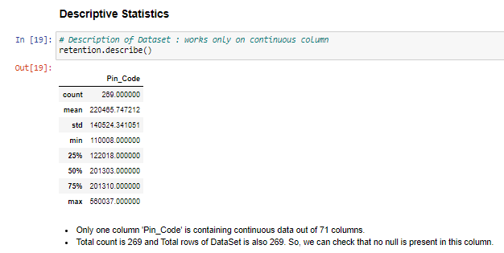
EDA Steps and assumptions for data study

Slide 17
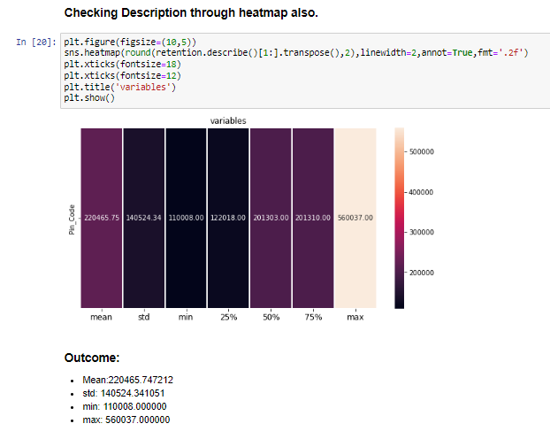
EDA Steps and assumptions for data study

Slide 18
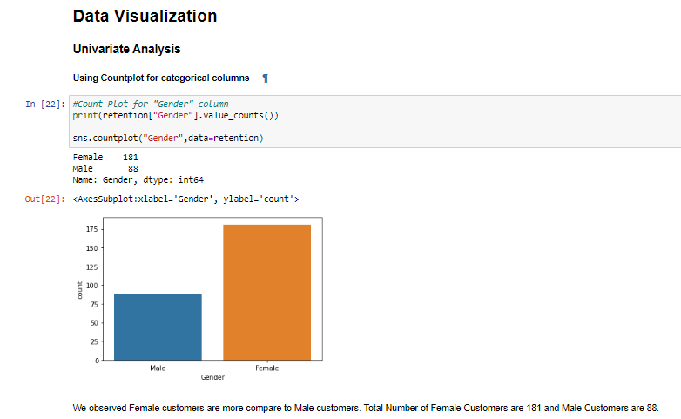
Data Visualization : Based on Gender

Slide 19
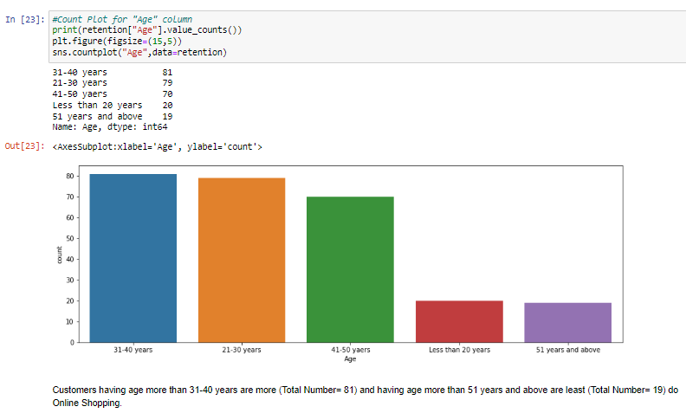
Data Visualization : Based on Age

Slide 20
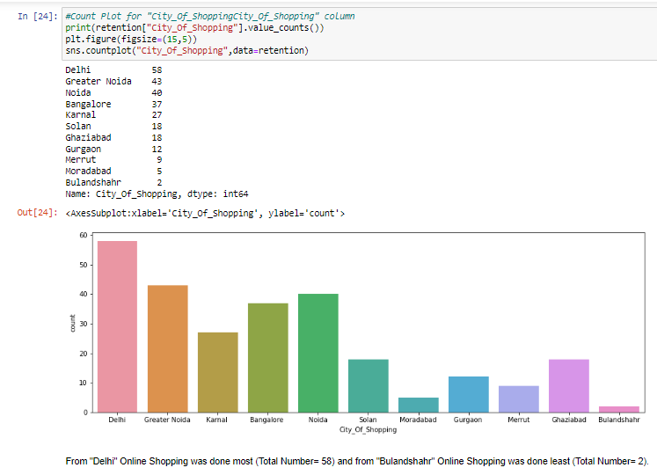
Data Visualization : Based on City

Slide 21
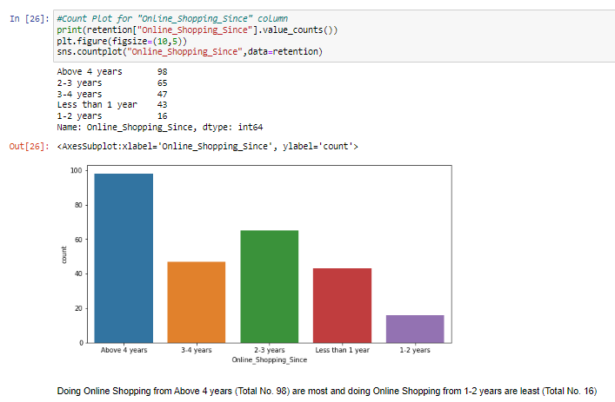
Data Visualization : Based on Online Usage time

Slide 22
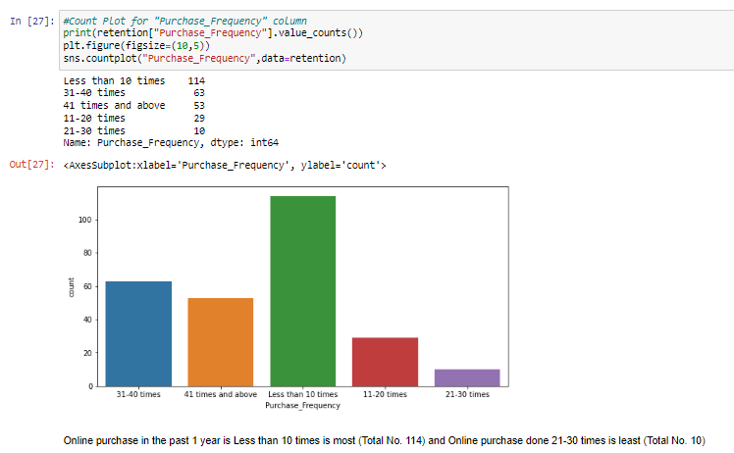
Data Visualization : Based on Purchase Frequency

Slide 23
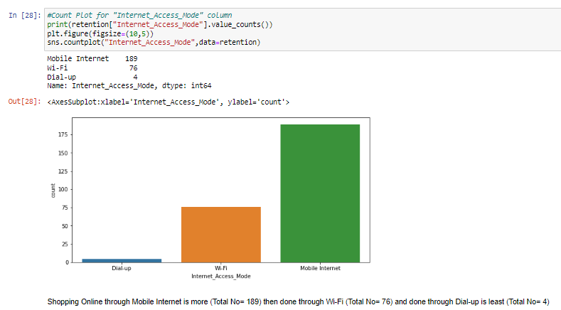
Data Visualization : Based on Internet Access Mode

Slide 24
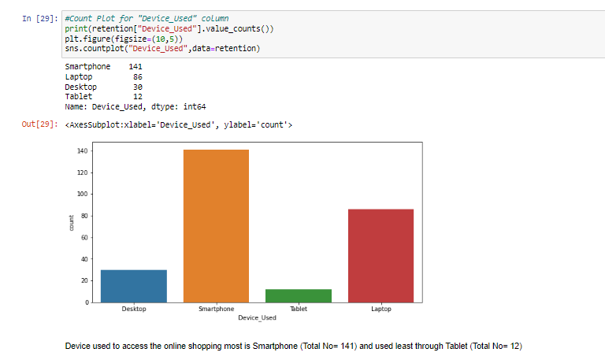
Data Visualization : Based on Device Used

Slide 25
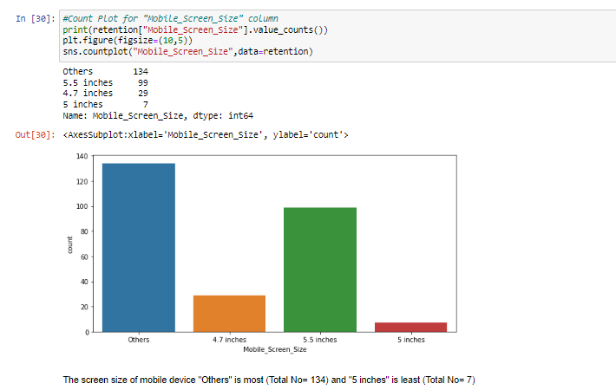
Data Visualization : Based on Mobile Screen Size

Slide 26
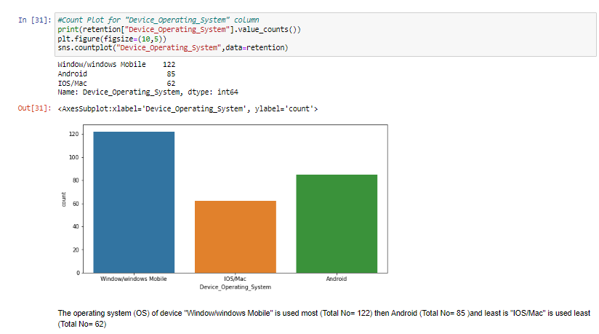
Data Visualization : Based on Device OS

Slide 27
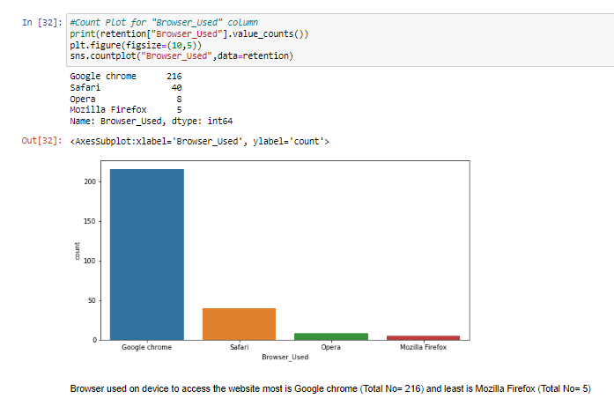
Data Visualization : Based on Browser used

Slide 28
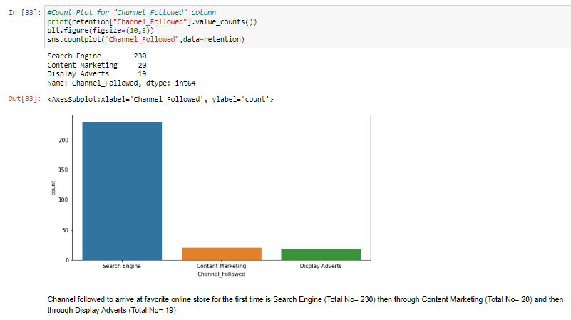
Data Visualization : Based on Channel Followed

Slide 29
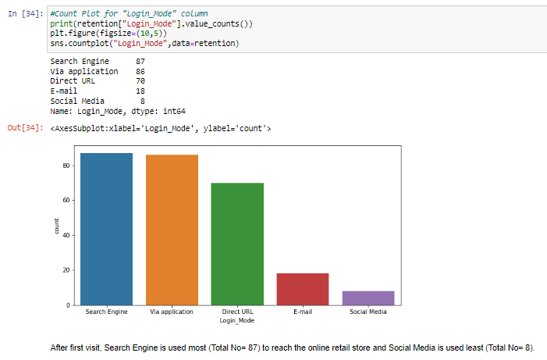
Data Visualization : Based on Login mode

Slide 30
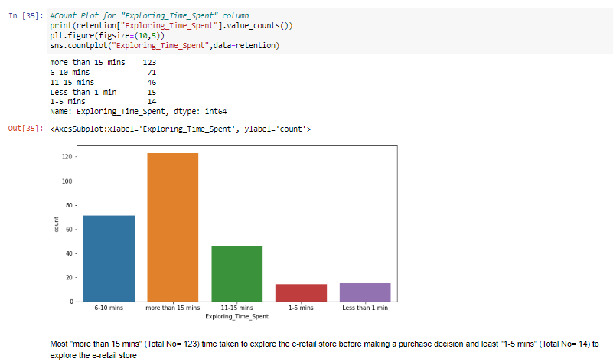
Data Visualization : Based on Exploring time

Slide 31
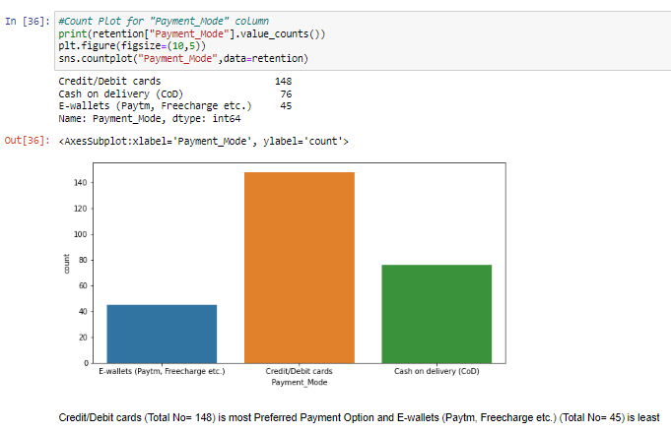
Data Visualization : Based on Payment mode

Slide 32
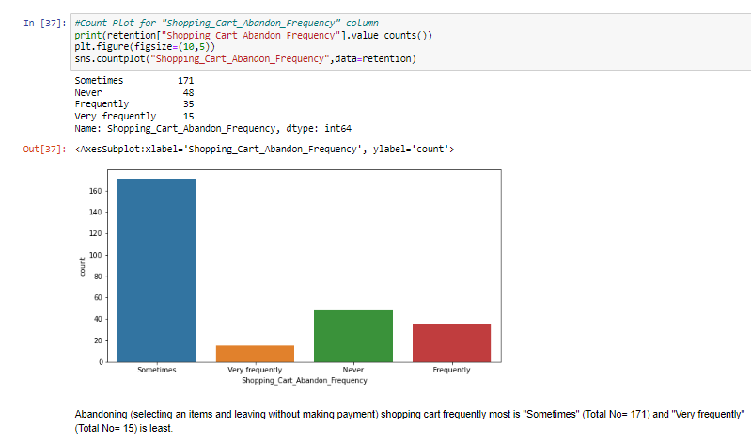
Data Visualization : Based on Shopping Cart Abandon frequency

Slide 33
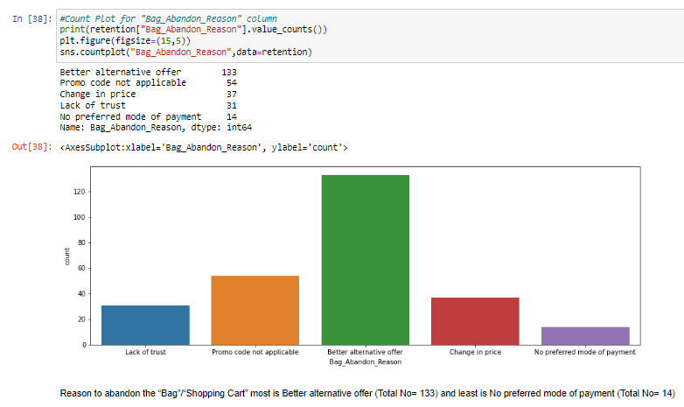
Data Visualization : Based on Bag Abandon Reason

Slide 34
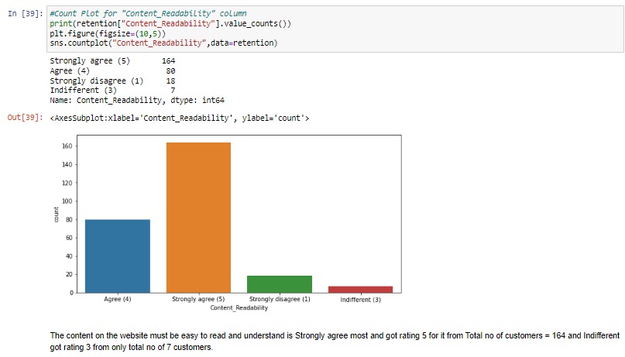
Data Visualization : Based on Content Readability

Slide 35
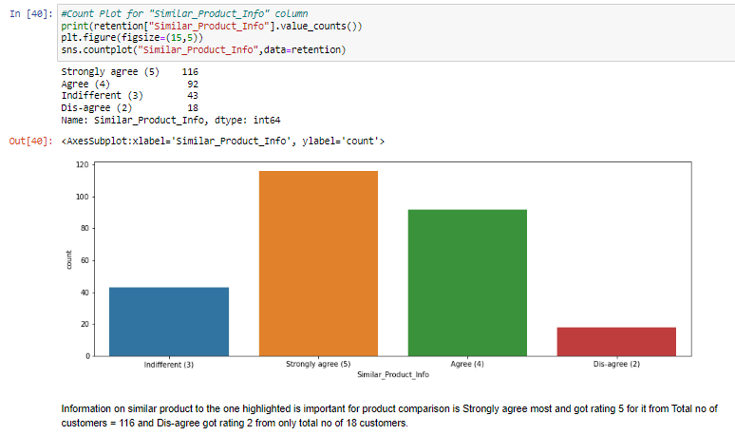
Data Visualization : Based on Similar product Info

Slide 36
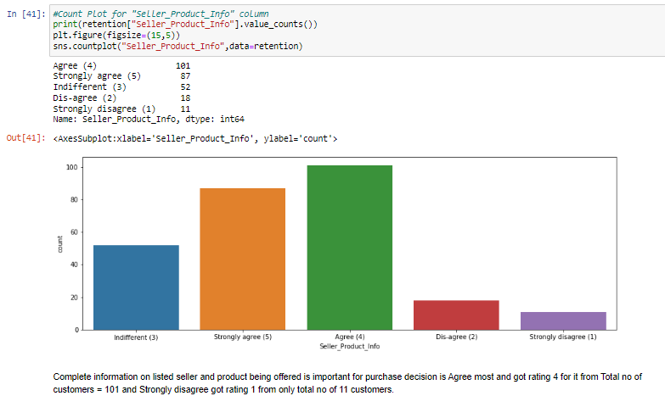
Data Visualization : Based on Seller Product Info

Slide 37
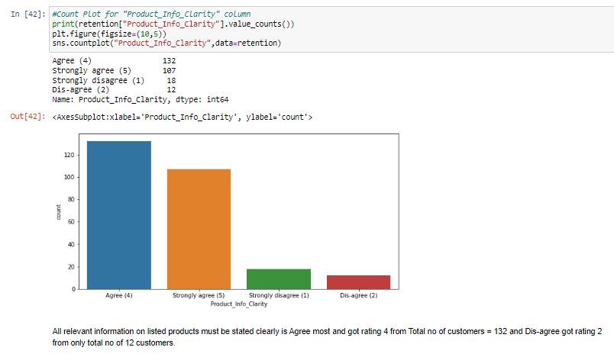
Data Visualization : Based on Product Info Clarity

Slide 38
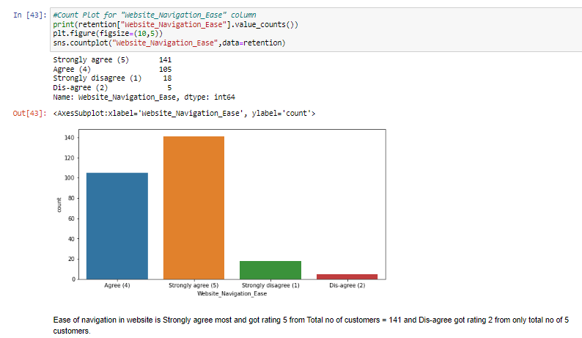
Data Visualization : Based on Website Navigation ease

Slide 39
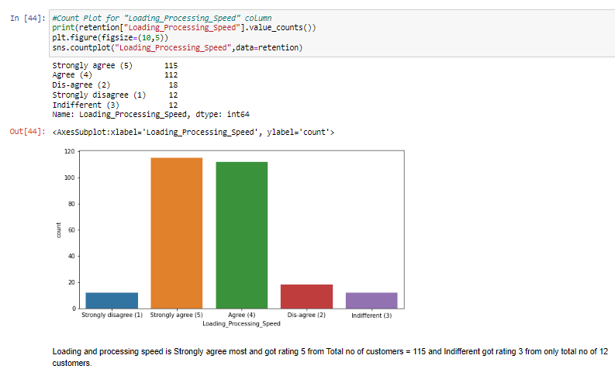
Data Visualization : Based on Loading speed

Slide 40
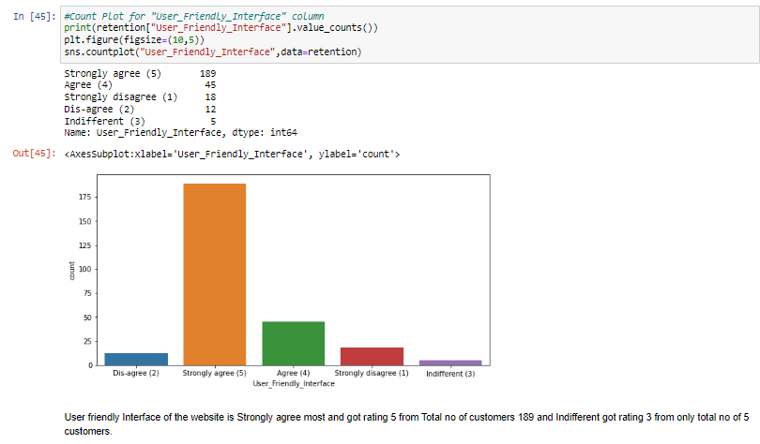
Data Visualization : Based on User Friendly Interface

Slide 41
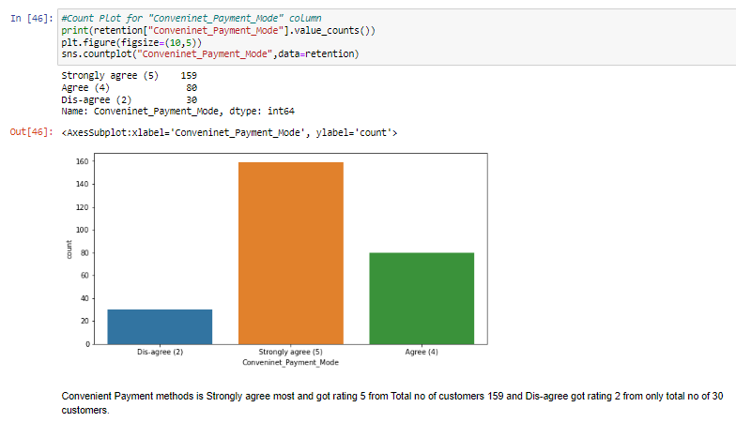
Data Visualization : Based on Convenient Payment mode

Slide 42
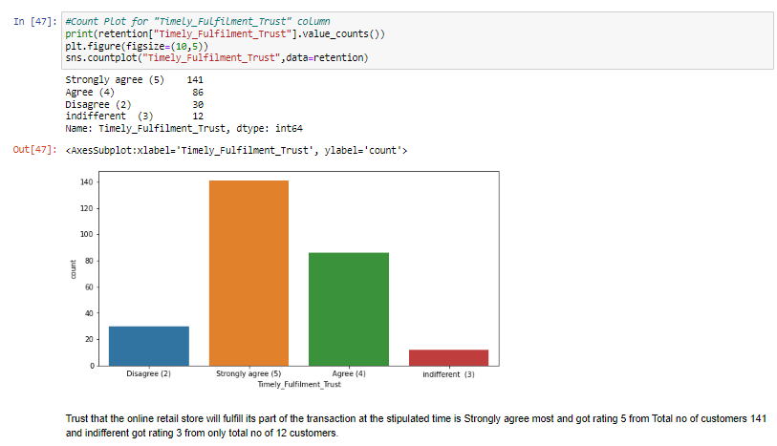
Data Visualization : Based on Timely Fulfillment trust

Slide 43
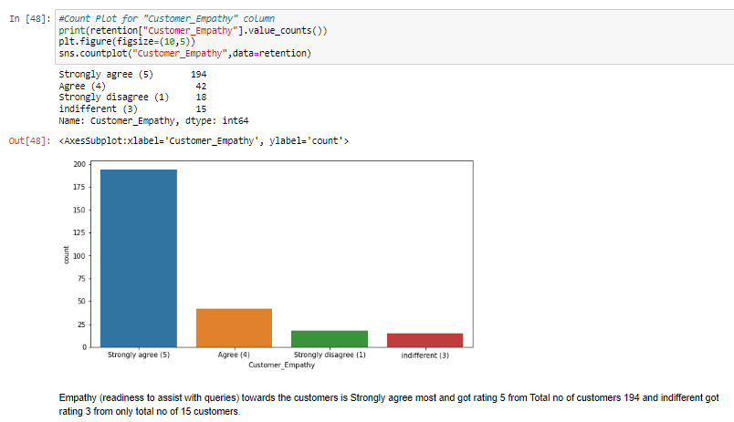
Data Visualization : Based on Customer Empathy

Slide 44
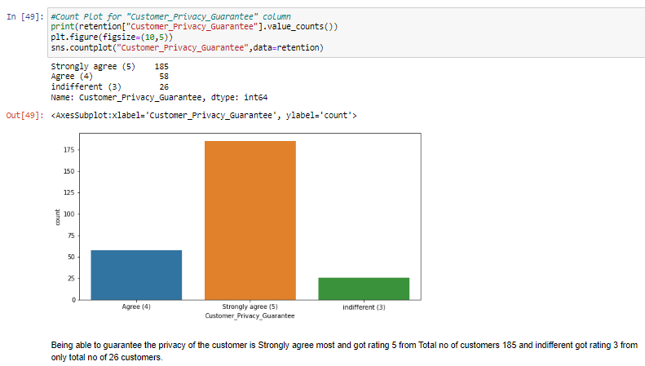
Data Visualization : Based on Customer Privacy Guarantee

Slide 45
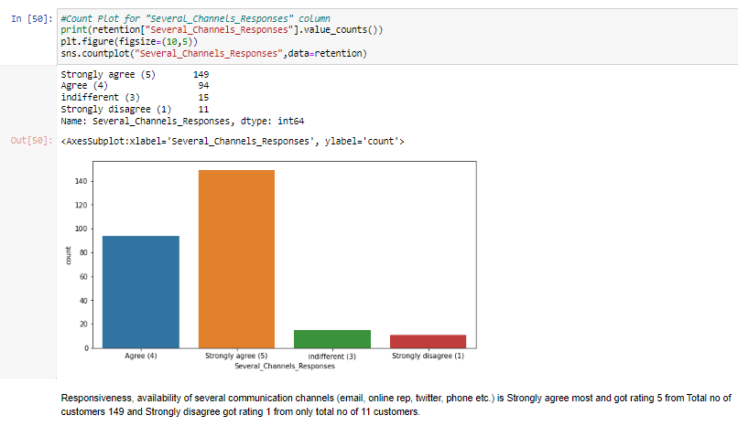
Data Visualization : Based on Several Channel Response

Slide 46
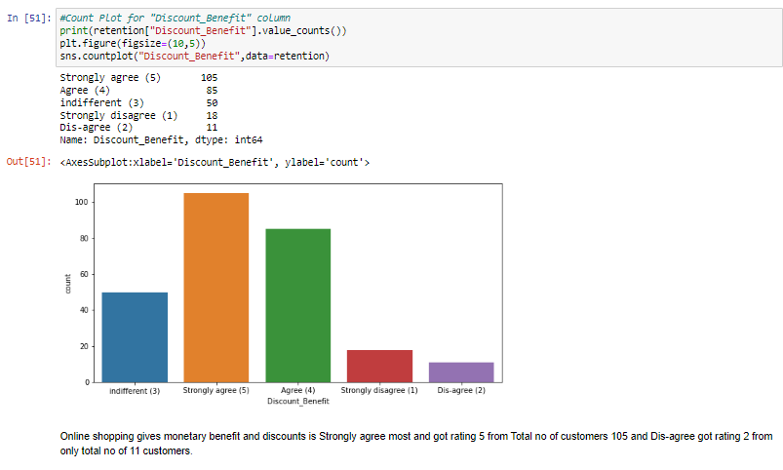
Data Visualization : Based on Discount Benefit

Slide 47
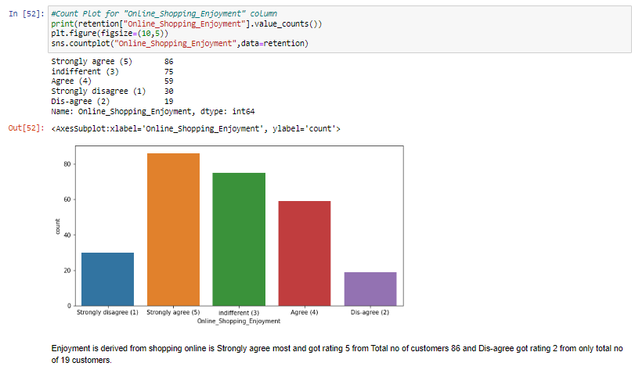
Data Visualization : Based on Online Shopping Enjoyment

Slide 48
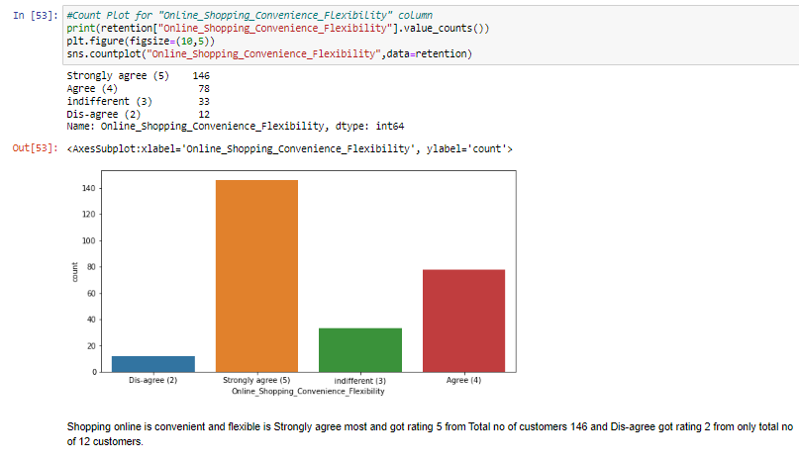
Data Visualization : Based on Online Shopping Convenience Flexibility

Slide 49
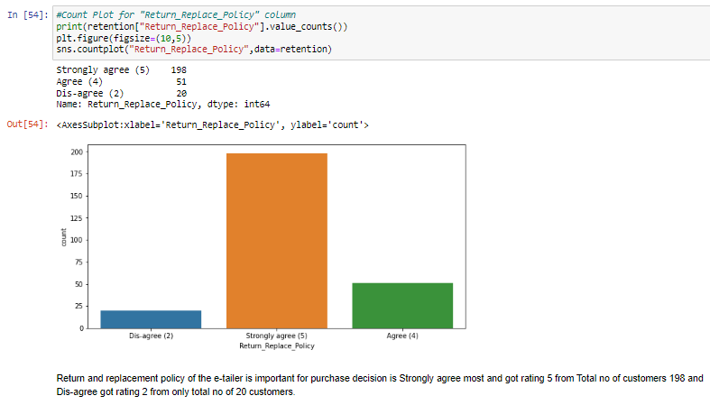
Data Visualization : Based on Return Replace Policy

Slide 50
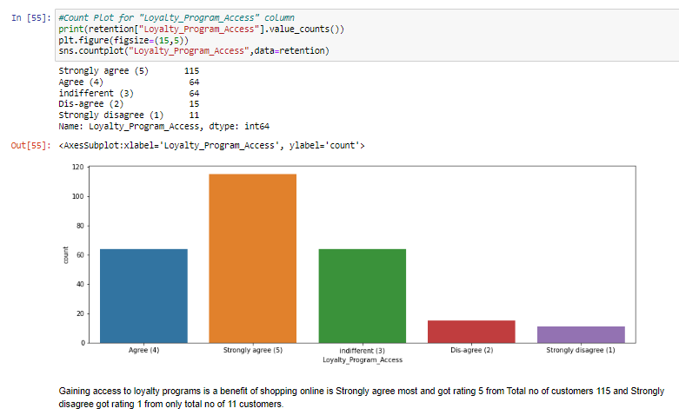
Data Visualization : Based on Loyalty Program Access

Slide 51
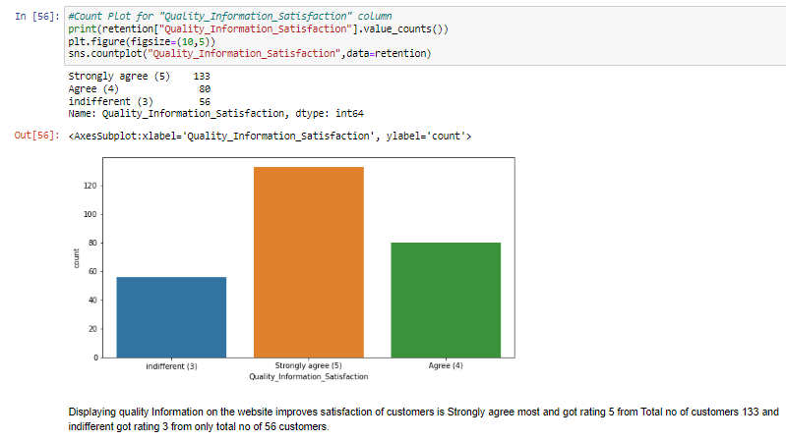
Data Visualization : Based on Quality Information Satisfaction

Slide 52
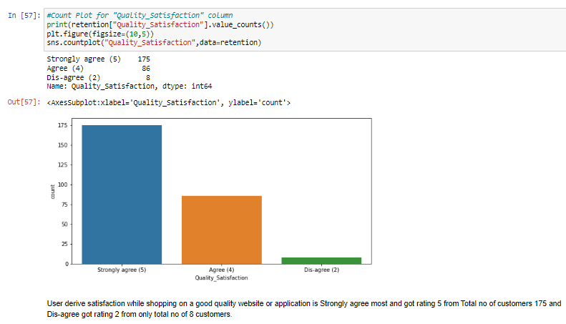
Data Visualization : Based on Quality Satisfaction

Slide 53
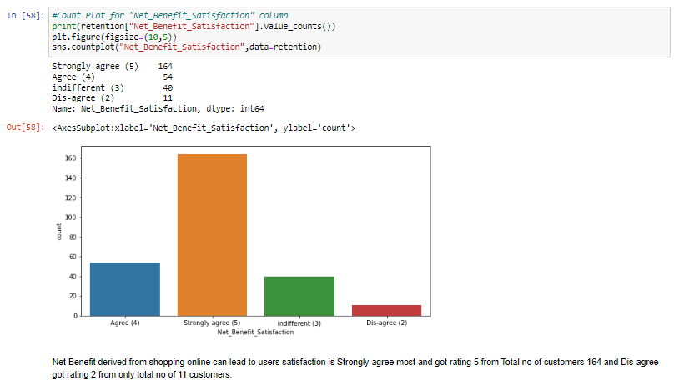
Data Visualization : Based on Net Benefit Satisfaction

Slide 54

Data Visualization : Based on Users Trust

Slide 55

Data Visualization : Based on Product Categories

Slide 56

Data Visualization : Based on Relevant product Information

Slide 57

Data Visualization : Based on Monetary Savings

Slide 58

Data Visualization : Based on Patronizing Convenience

Slide 59

Data Visualization : Based on Adventure Sense

Slide 60

Data Visualization : Based on Enhances Social status

Slide 61

Data Visualization : Based on Shopping Gratification

Slide 62

Data Visualization : Based on Role Fulfillment

Slide 63

Data Visualization : Based on Worth of Money

Slide 64

Data Visualization : Based on Shopped from Retailer

Slide 65

Data Visualization : Based on Shopped from Retailer

Slide 66

Data Visualization for Ease Website Application

Slide 67

Data Visualization for Visually Appealing Layout

Slide 68

Data Visualization for Product Variety

Slide 69

Data Visualization for Complete Product Information

Slide 70

Data Visualization for Fast Loading Speed Web App

Slide 71

Data Visualization for Reliable Website Application

Slide 72

Data Visualization for Quick Purchase

Slide 73

Data Visualization for Payment Options

Slide 74

Data Visualization for Fast Delivery

Slide 75

Data Visualization for Customer Info Privacy

Slide 76

Data Visualization for Customer Financial Info Security

Slide 77

Data Visualization for Perceived Trustworthiness

Slide 78

Data Visualization for Multi Channel Assistance

Slide 79

Data Visualization for Loading logging Time

Slide 80

Data Visualization for Loading Graphic Photo Display time

Slide 81

Data Visualization for Late Price Declare

Slide 82

Data Visualization for Page Loading Time

Slide 83

Data Visualization for Limited payment mode

Slide 84

Data Visualization for Late Delivery

Slide 85


Data Visualization for Web page performance

Slide 86


Data Visualization for Website recommendation

Slide 87

Bivariate Analysis
We can see Male customers of:
Age 31-40 years : 30
Age 21-30 years : 20
Age 41-50 years : 28
Age less than 20 years : 8
Age 51 years and above : 5
And Female Customers of:
Age 31-40 years : 50
Age 21-30 years : 58
Age 41-50 years : 42
Age less than 20 years : 12
Age 51 years and above : 15

Slide 88

Observation & Conclusion

Slide 89

Observation & Conclusion

Slide 90

Observation & Conclusion

Slide 91

Observation & Conclusion

Slide 92

Observation & Conclusion

Slide 93

Observation & Conclusion

Slide 94

Observation & Conclusion

Slide 95

Observation & Conclusion

Slide 96

Observation & Conclusion

Slide 97

Observation & Conclusion

Slide 98

Observation & Conclusion

Slide 99

Observation & Conclusion

Slide 100

Observation & Conclusion

Slide 101

Observation & Conclusion

Slide 102

Observation & Conclusion

Slide 103
Observation & Conclusion
Efficient Website with Fastest Delivery is Amazon. In according to customers.
High Customer Satisfaction from website:
Amazon.com
Flipkart.com
High Risk from website:
Myntra.com
Snapdeal.com
Website recommendation to a friend:
Amazon. In
Flipkart.com

Slide 104
Observation & Conclusion
Most Customer believe that the content on the website must be easy to read and understand.
Most Customer agree that information on similar product to the one highlighted is important for product comparison.
Most Customer (70%) believe that Complete information of listed seller and product is important for purchase decision.
Most Customer (90%) agree Shopping online is convenient and flexible.
Most Customer (70%) believe that Enjoyment is derived from shopping online.
Most Customer believe that Online shopping gives monetary benefit and discounts.
Getting value for money spent on Online Shopping.
Return and replacement policy is important for purchase decision according to 90% customers.
Gaining access to loyalty programs is a benefit of shopping online.
Most Customer (90%) believe that All relevant information on listed products must be stated clearly.
Most Customer (80%) believe that Displaying quality Information on the website improves satisfaction of customers.

Slide 105
Observation & Conclusion
More than 90% Customer wants website to be:
Easy to navigate
Loading and processing speed fast
User friendly Interface
Convenient Payment methods
Guarantee the privacy of the customer
Availability of several communication channels (email, online rep, twitter, phone etc.)

Slide 106
Observation & Conclusion
60-80 % Customer believe that:
Shopping on your preferred Retailer enhances your social status
You feel gratification shopping on your favorite retailer
Shopping on the website helps you fulfill certain roles

Slide 107
Observation & Conclusion
Customer "Strongly Agree" (rating 5) to:
Shopping on a good quality website or application
Net Benefit derived from shopping online
Customer Trust
Offering a wide variety of listed product in several category
Provision of complete and relevant product information
Monetary savings
The Convenience of patronizing the online retailer
Shopping on the website gives you the sense of adventure

Slide 108
Closing Note
E-commerce to take into account their customer satisfaction because this will retain customer loyalty as well as attract potential customers

Slide 109


